Slide 1
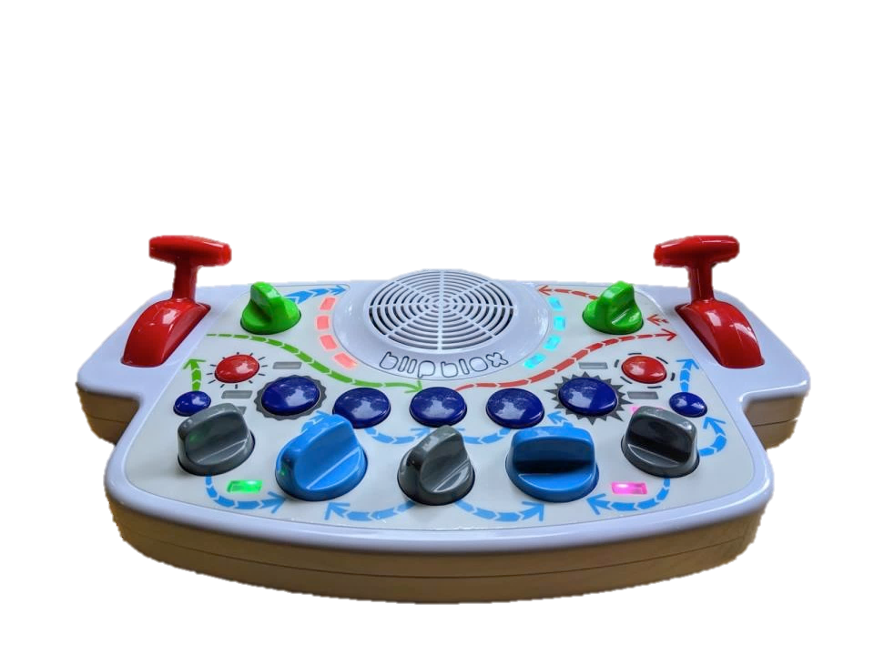
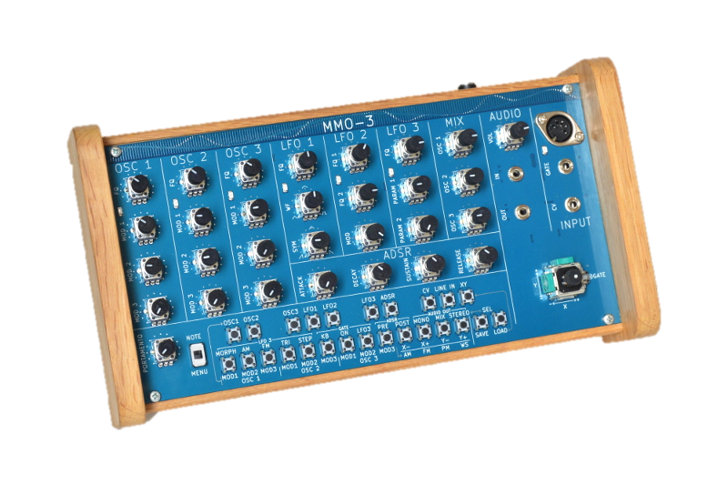
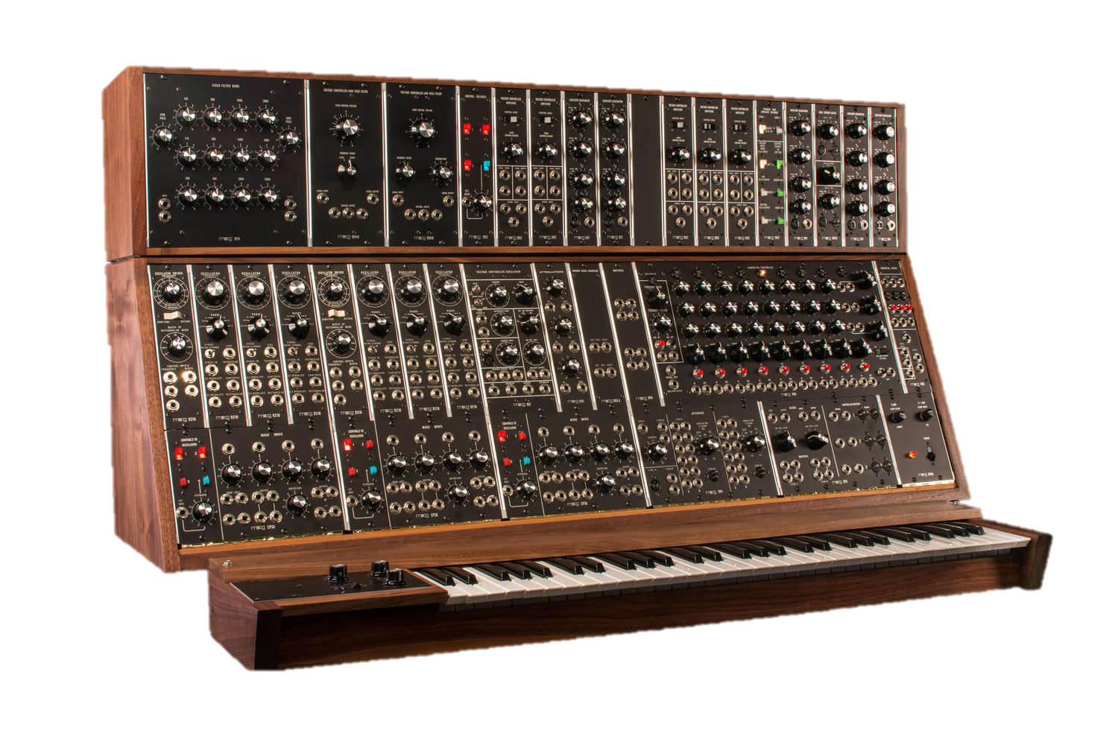
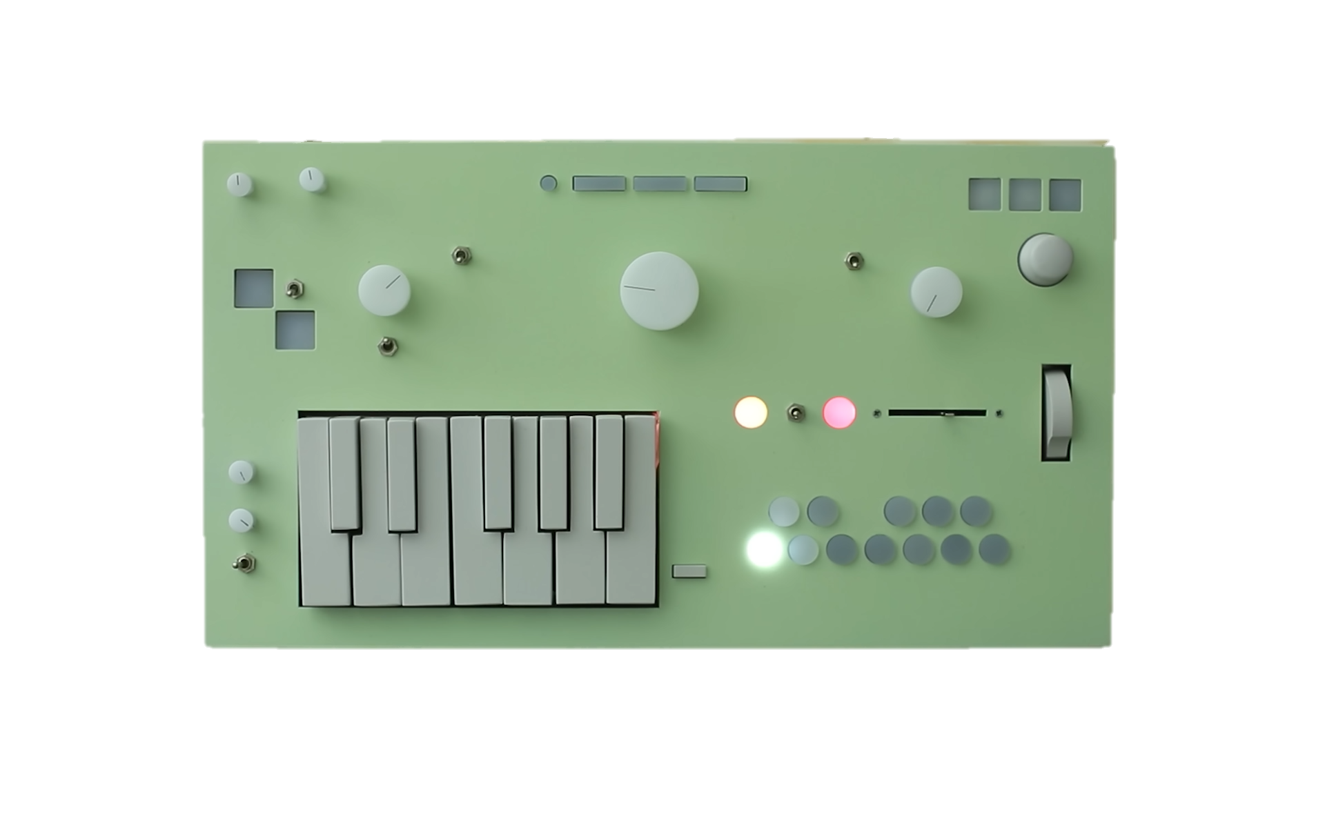

Slide 2
Synthesizer - noun
syn·​the·​siz·​er
a usually computerized electronic apparatus for the production and control of sound (as for producing music)

Slide 3
Synthesizer - noun
syn·​the·​siz·​er
an electronic apparatus capable of producing a wide range of sounds, thus providing for a meditative experience

Slide 4
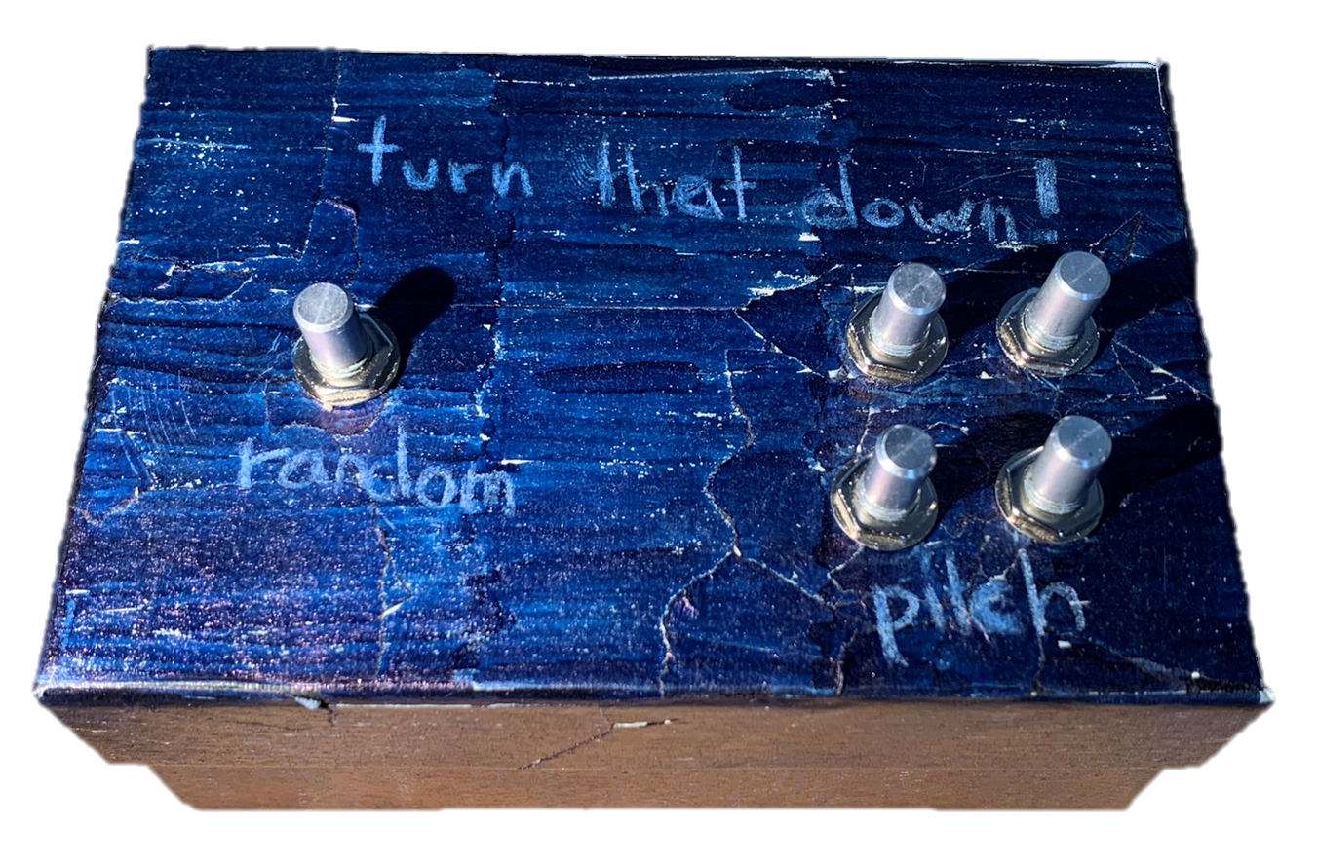
t u r n
t h a t
!
d o w n

Slide 5
turn that down! The Creation of a Synthesizer

Slide 6

content
motivation
theory
my synthesizer
work process
conclusion
demo

Slide 7
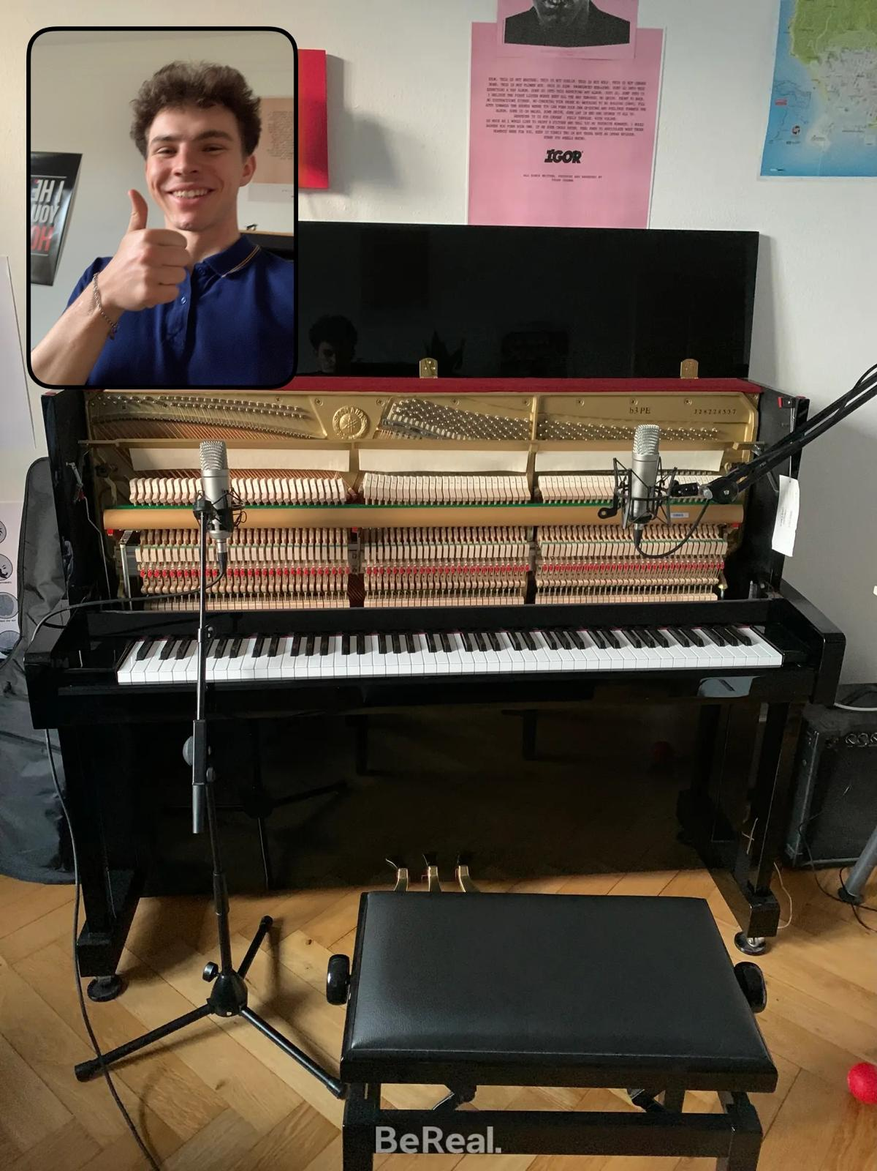
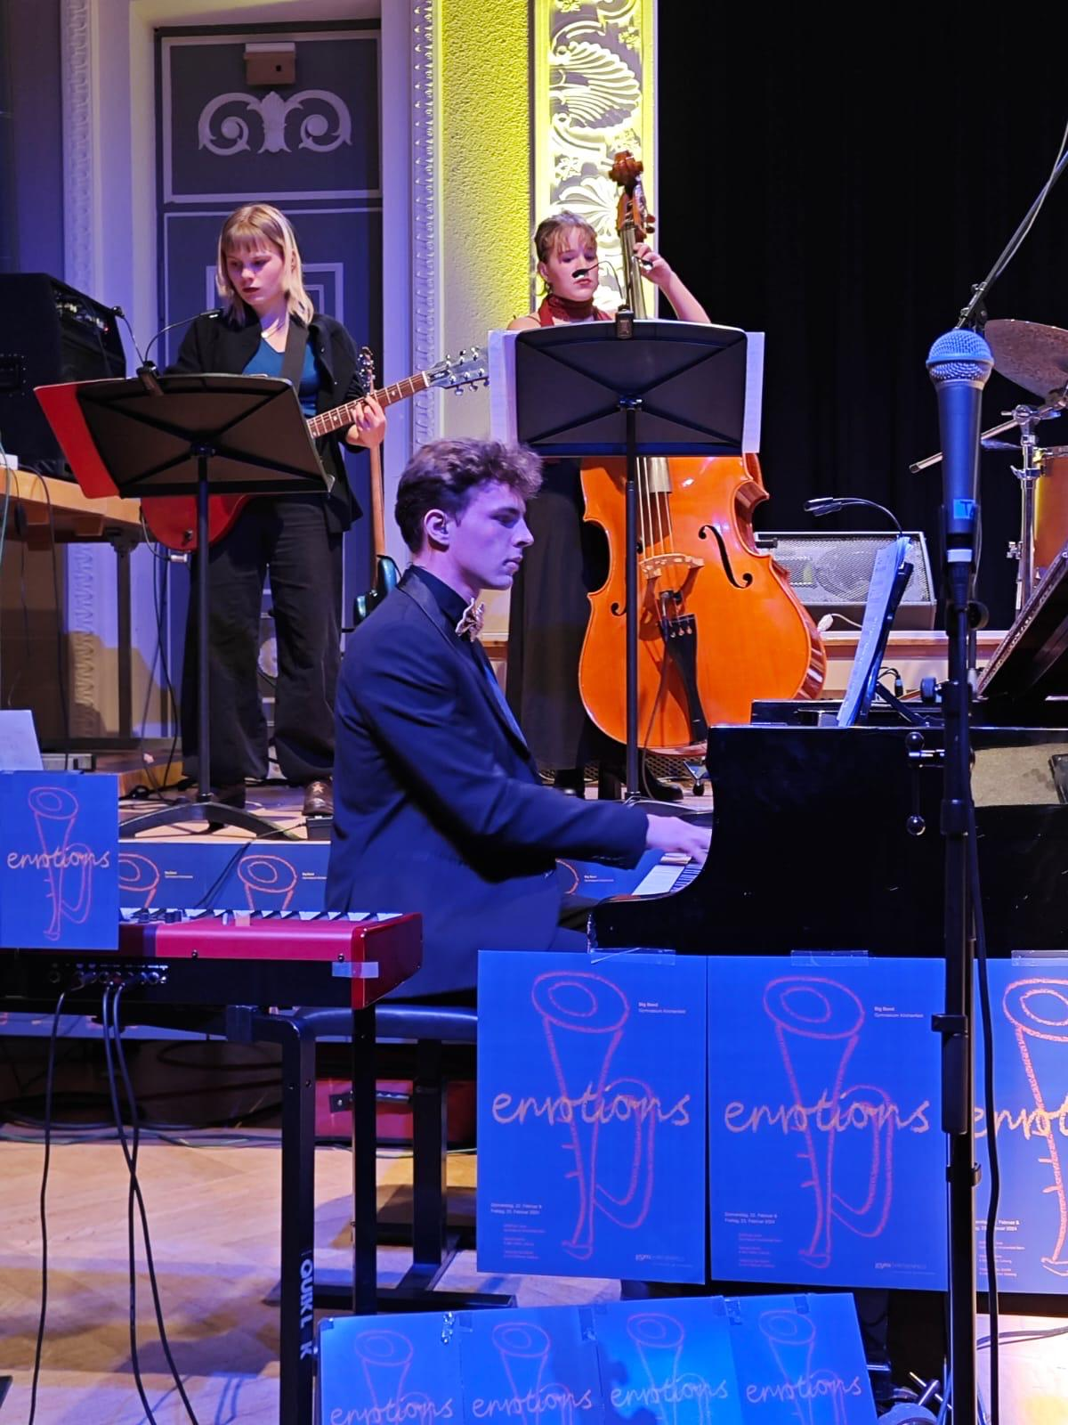

motivation

Slide 8
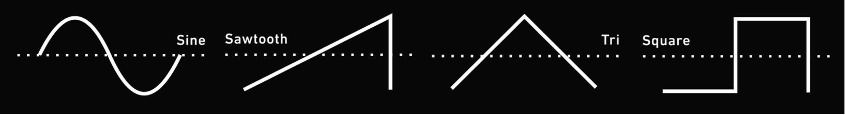
theory

Slide 9
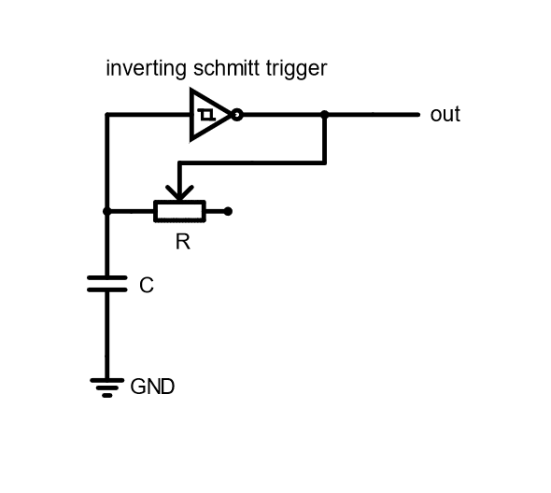
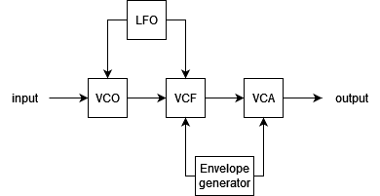
theory

Slide 10
theory
VCO
VCF
VCA
LFO
voltage controlled oscillator
voltage controlled filter
voltage controlled amplifier
low frequency oscillator
envelope generator

Slide 11
theory
VCO
MA, square wave
voltage controlled oscillator

Slide 12
theory
VCF
voltage controlled filter

Slide 13
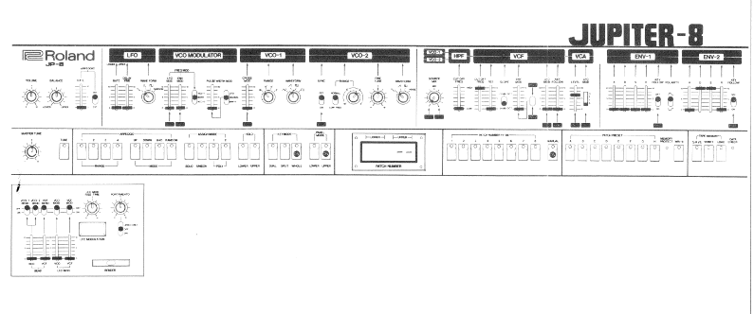
theory
VCO
VCF

Slide 14
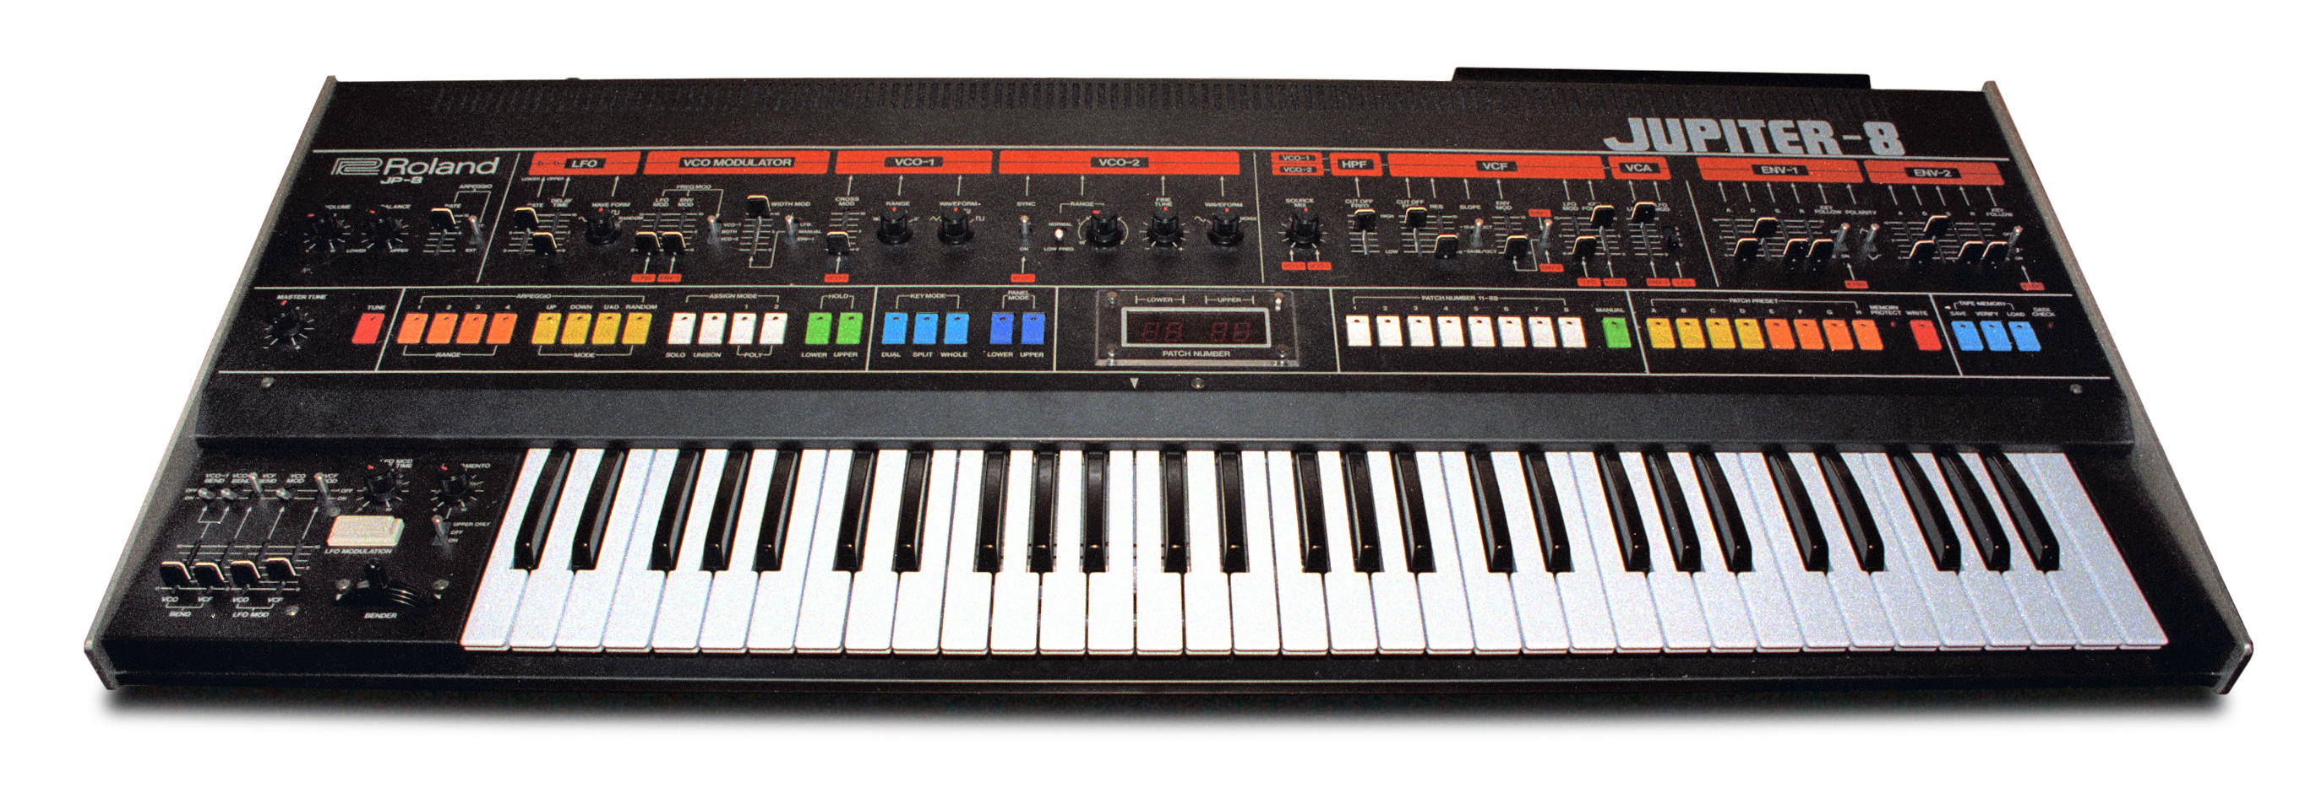
VCO
VCF

Slide 15
theory
VCO
VCF

Slide 16
theory
VCO
VCF

Slide 17
theory
VCO
VCF

Slide 18
theory
VCO
VCF

Slide 19


my synthesizer
oscillator 1
oscillator 3
output
low pass filter
oscillator 2
oscillator 4

Slide 20
my synthesizer
osc 3
osc 4
random
osc 1
osc 2

Slide 21
work process

Slide 22
conclusion

Slide 23
demonstration

Slide 24
sources
Moog 08.12 https://www.moogmusic.com/news/return-moog-modular
Children 08.12 https://www.engadget.com/2019-07-03-blipblox-hands-on-synthesizer-for-kids.html
Mmo-3 08.12 https://www.factmag.com/2017/05/24/nozoid-mmo-3-drone-synth/
Nopia 08.12 https://youtu.be/Ivuy9QYLFVY

